Slide 1
“A Better Ear”
By: John Watson and Curtis McClelland

Slide 2
Mission
Our mission with A Better Ear is to educate the public about the constant struggles faced by a student with ADHD in a public classroom setting
Another goal is to allow the classroom space to be more inviting and better suited for students with this condition

Slide 3
ADHD facts
Two groups: Inattentive and hyperactive-impulsive
Many ADHD students have elements of both
(ADD)

Slide 4
Inattentive ADHD symptoms
Makes careless mistakes in school work, overlooks details
Is easily distracted or sidetracked
Has difficulty following instructions
Doesn’t seem to be listening when spoken to directly
Has trouble organizing tasks and possessions
Often fails to finish work in school or chores in the classroom
Often avoids or resists tasks that require sustained mental effort, including doing homework
Often loses homework assignments, books, jackets, backpacks, sports equipment

Slide 5
Hyperactive-Impulsive ADHD symptoms
Often fidgets or squirms
Has trouble staying in his seat
Runs and climbs where it’s inappropriate
Has trouble playing quietly
Is extremely impatient, can’t wait for his turn
Always seems to be “on the go” or “driven by a motor”
Talks excessively
Blurts out answers before a question is completed
Interrupts or intrudes on others conversations, activities, possessions

Slide 6
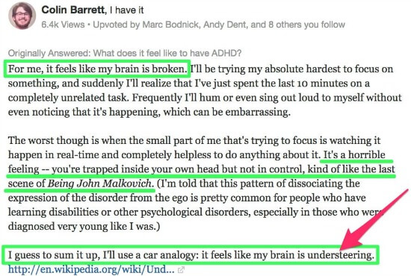
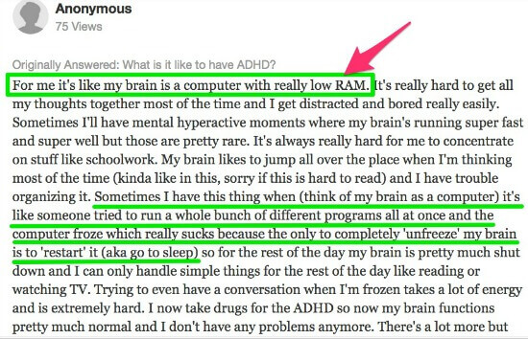
Life With ADHD
https://www.adhdcollective.com/what-does-it-feel-like-to-have-adhd/

Slide 7



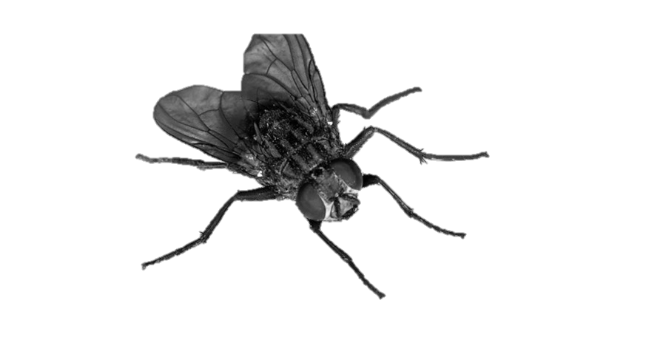
Visual Representation
Notes:
Emphasize how the student has trouble focusing, only certain things stick out to them.

Slide 8
Brain test
Idea: Two students - both about the same intelligence level
Both will take a math quiz at the same time
One student will be in a silent room with no distractions
The other will have loud music through headphones, flashing lights and other distracting material
Students will switch and take the others test
Shows the difficulties of trying to concentrate with other stimuli involved

Slide 9
Brain test 2
Idea: A tray of 20 random items will be set out with two participants
One participant will have a conversation about anything during the game
Participants will have 60 seconds to memorize the items on the tray
The tray will be removed and contestants will have another 60 seconds to write down any items they can remember
The answers from the person carrying conversation versus not will be compared
Shows how hard it is to multitask for an ADHD person

Slide 10
Purpose of Tests/Conclusion
These two aforementioned tests demonstrate what it is like to live with attention deficits in the classroom.
“A Better Ear” would serve as a link between the student and the content they are learning, and help cut out distractions as well as help these students work outside of the classroom.

Slide 11
Sources
https://childmind.org/article/whats-adhd-and-whats-not-in-the-classroom/

